Slide 1
Human Computer interaction (HCI)

Slide 2
Introduction
UI/interface design defines how a system interacts with external entities (users, other systems)
HCI: how a user interacts with a system
Navigation
I/O (input/output) mechanisms

Slide 3
User Interface (UI)
Navigation
How a user gives the system instructions
Example: Buttons, menu
Input
How the system captures information
Example: Forms for adding new customers
Output
How the system gives information to users or other systems
Example: Report, Web page

Slide 4
6 Principles for UI Design
Layout
Content Awareness
Aesthetics
Consistency
Minimal User Effort
User Experience

Slide 5
Principles for UI Design
Layout
Content Awareness
Aesthetics
Minimal User Effort
User Experience

Slide 6
Layout
The arrangement of items on the screen
Screen is divided into 3 general areas:
Top: navigation
Bottom: status area
Middle: displays reports and forms for data entry
Areas may be divided into subsections

Slide 7
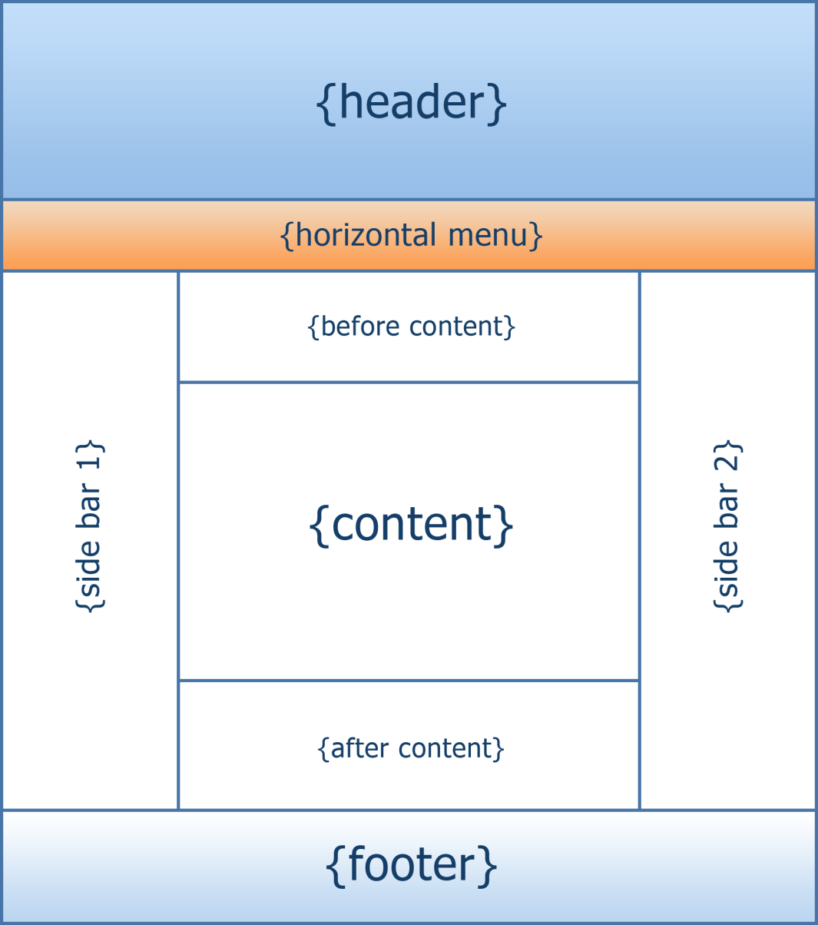
Layout

Slide 8
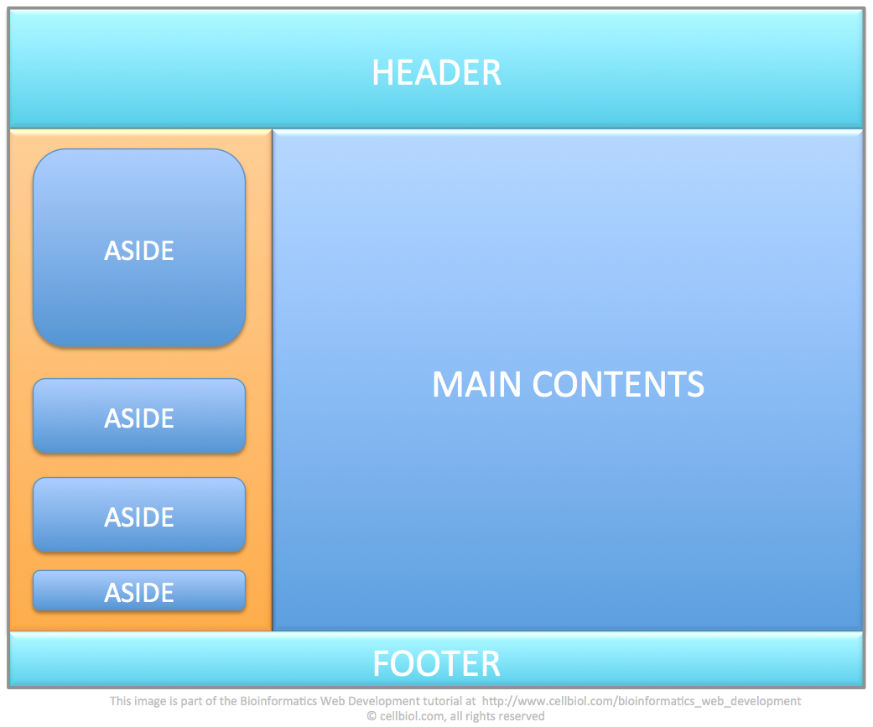
Layout

Slide 9
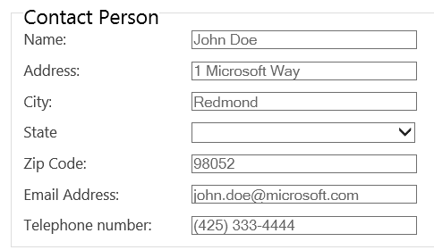
Layout
Areas should have an intuitive flow
Users from western nations read left to right, top-to-bottom, and forms should match this style

Slide 10
Layout
Amazon
CNN
Marist

Slide 11
6 Principles for UI Design
Layout
Content Awareness
Aesthetics
Minimal User Effort
User Experience

Slide 12
Content Awareness
An interface should make the user aware of information with the least amount of user effort
Examples:
Menus, search bar
Forms and reports:
All areas should be well defined and easy to read
Fields should have labels
Lines, bold, headings, colors…

Slide 13
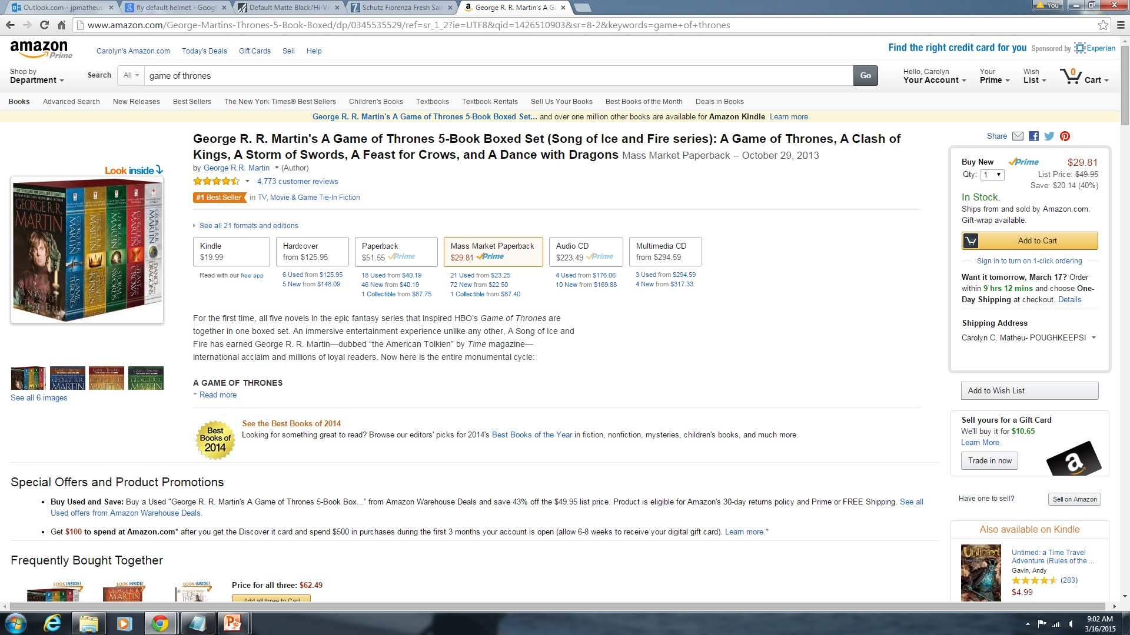
Content Awareness

Slide 14
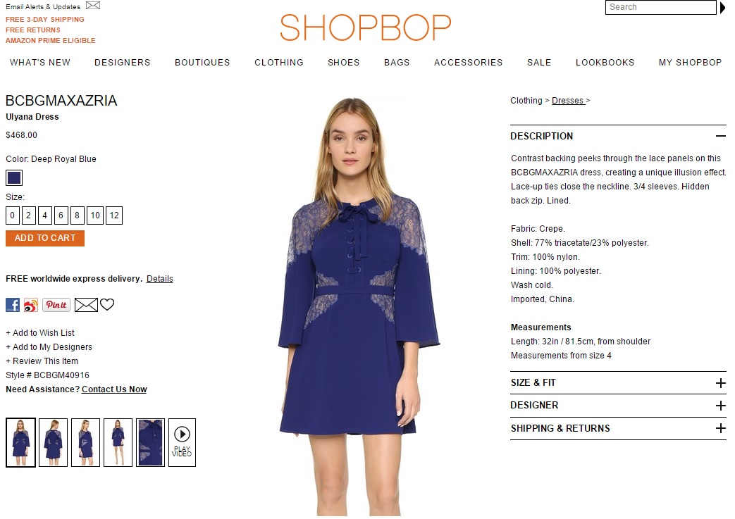
Content Awareness

Slide 15
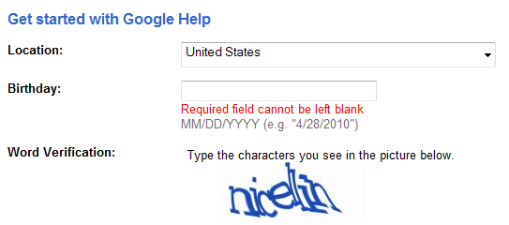
Content Awareness

Slide 16
6 Principles for UI Design
Layout
Content Awareness
Aesthetics
Minimal User Effort
User Experience

Slide 17

Aesthetics
Question: If you had to choose, is it more important to have a Web page that is functional or looks good?
Interface should be functional, inviting to use, and pleasing to the eye
Less is more/KISS

Slide 18
Aesthetics and White Space
How much white space should a Web page have?
How much white space do forms need? Does it depend on the frequency of a user?
Answer: less frequent users prefer low density (50%)

Slide 19
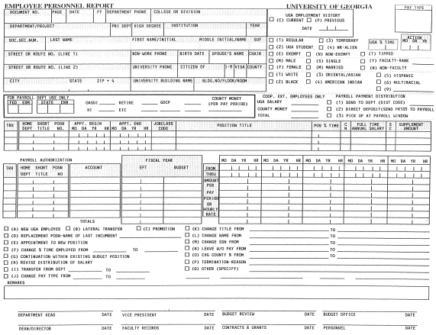
Aesthetics: High Density Web Form

Slide 20
Aesthetics and White Space
The Organizer may remove any Family member from the Family, which will terminate that Family member's ability to initiate authorized purchases on the Organizer's payment method, and that Family Member’s ability to view and share other Family members' products and information. When a Family member leaves or is removed from a Family, the remaining Family members may no longer be able to view or download the departing member’s products or information, or access products previously downloaded from the departing Family member, including purchases made on the Organizer's payment method while the departing member was part of the Family. Similarly, if you leave a Family, you may no longer be able to view or download the products or information of the other Family members, and products that you downloaded from other Family members while a member of the Family may no longer be accessible. If you have made In-App Purchases from an app originally purchased by a departed Family member or downloaded from a Family member and you no longer belong to the Family, you need to purchase the app yourself and restore the In-App Purchases to regain access to them; please review the developer’s policies and the section of this Agreement entitled “In-App Purchases” before buying In-App Purchases. Because personal accounts for users under age 13 can only be created as part of Family Sharing, deleting such an account in order to remove it from the Family will terminate that Family member’s Apple ID and his or her ability to access any Apple services that require an Apple ID or any content associated with that Apple ID. You can only belong to one Family at a time, and may join any Family no more than twice per year. You can change the store account you associate with a Family no more than once every 90 days. All Family members must use the same iTunes Store country or region. Music, movies, TV shows and books can be downloaded from the iTunes Service on up to 10 devices per account, only five of which can be computers; eligible apps can be downloaded to any devices the Family member owns or controls. Not all products, including In-App Purchases, content that is not available for re-download, subscriptions, and some previously purchased apps, are eligible for Family Sharing. Apple reserves the right to disband a Family in accordance with the “Termination” section of this Agreement.

Slide 21



Aesthetics and White Space
Think of white space as the default
Everything starts as white space until you take it away by adding page elements
Examples:
Instagram
Facebook
Spotify

Slide 22
Aesthetics and White Space
Put spaces between your lines
Put spaces between your elements
Put spaces between your groups of elements
Pay attention to the site you use
Analyze what works and what doesn’t

Slide 23
Aesthetics and Text
Choose your font types and sizes carefully
Serif fonts: best for printed reports
Times New Roman
Sans serif fonts: most readable on computer screens
Calibri
Arial

Slide 24
Aesthetics and Text
Styling text:
Styles that INCREASE text visibility
Styles that decrease text visibility

Slide 25
Aesthetics and Text
Methods of calling attention TO (or away from) text:
Size
Color
Font weight
Capitalization
Italicization
Letter spacing

Slide 26
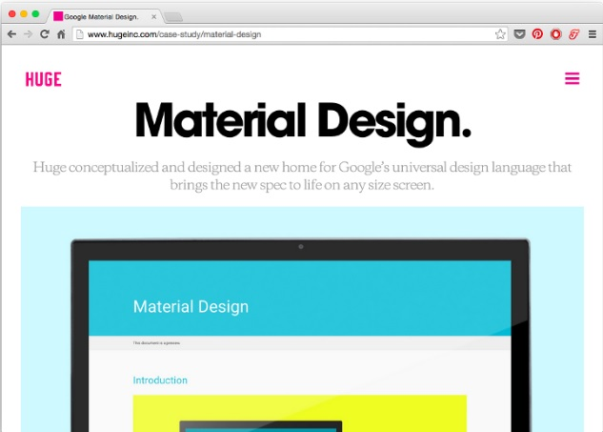
Up-Pop: big, high contrast, bold

Slide 27

Down-Pop: small, low contrast, less bold font weight

Slide 28
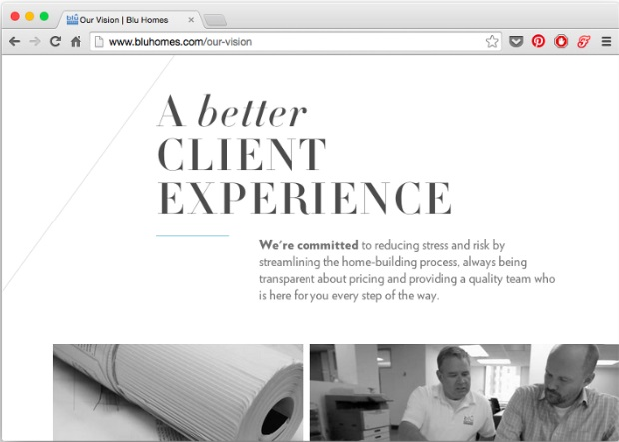
Up-Pop and Down-Pop Combinations
(Notice that the emphasized word is lower case)

Slide 29
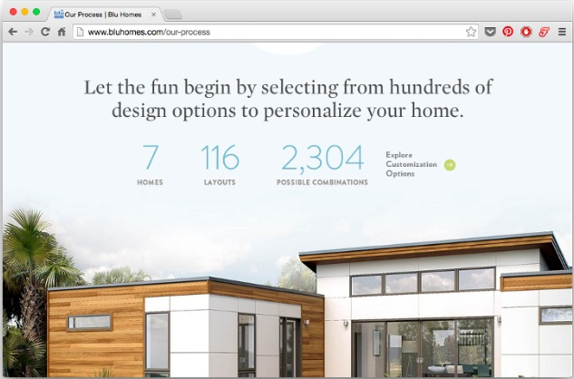
Aesthetics and Text
Notes:
Where is your eye drawn?
Size and color of numbers is downplayed with light font weight and lower color contrast

Slide 30
Aesthetics
Other considerations for your audience:
Older people need larger fonts
10% of men are color blind

Slide 31
Aesthetics and Text Color
Black on White

Slide 32
Aesthetics and Text Color
White on Black

Slide 33
Aesthetics and Text Color
Red on Blue

Slide 34
Aesthetics and Text Color
Blue on Red

Slide 35
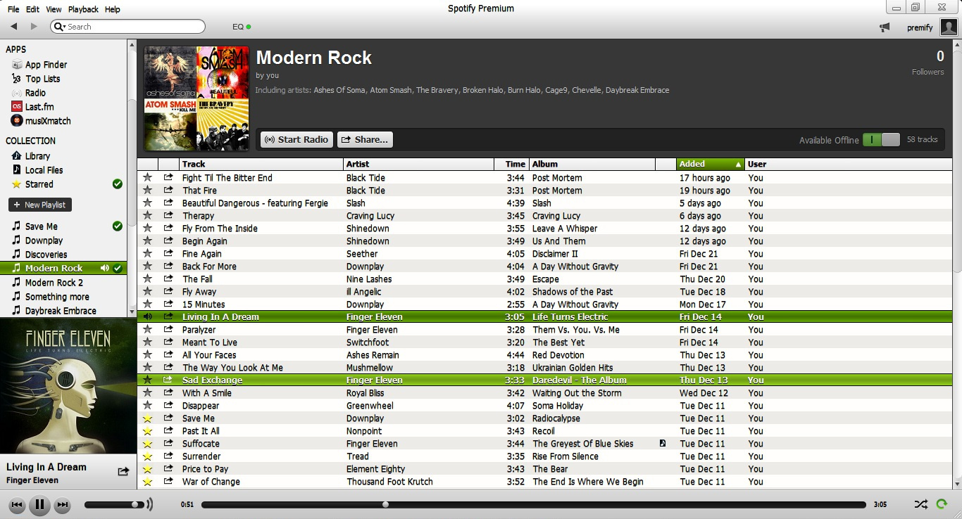
Spotify Interface: Old

Slide 36
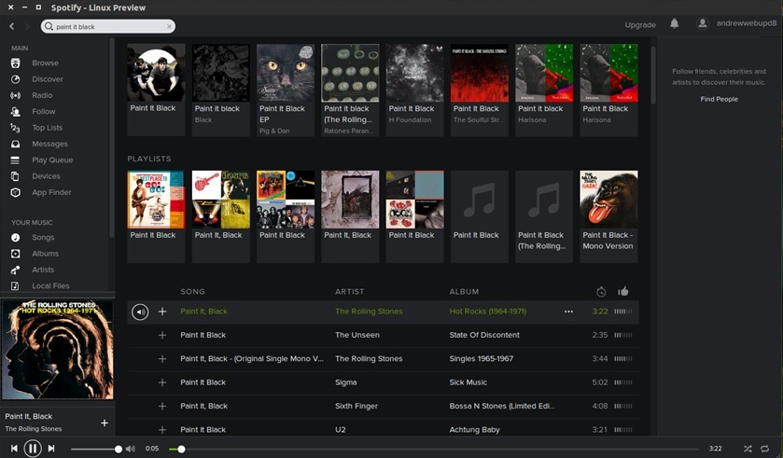
Spotify Interface: New

Slide 37
6 Principles for UI Design
Layout
Content Awareness
Aesthetics
Minimal User Effort
User Experience

Slide 38
Minimal User Effort
Question: Should you minimize the number of clicks or keystrokes for moving a user through a system?
3 clicks rule: users should be able to go from main menu to the information they want in 3 clicks or keystrokes

Slide 39
Minimal User Effort
Krug’s principles (434-435): User should not have to think about interface navigation
Interfaces should be designed for users to scan, not read
Consider billboard and newspaper design
Number of clicks is irrelevant so long as navigation choices are clear
KISS and provide feedback

Slide 40
Feedback
Maintain feedback and communication with users through subtle animations that show an action is being carried out
Examples:
Bouncing icon (app is opening)
Minimize screen

Slide 41
6 Principles for UI Design
Layout
Content Awareness
Aesthetics
Minimal User Effort
User Experience

Slide 42
User Experience
How would you design a Web page or system differently for novice versus experienced users?

Slide 43
User Experience: Novice User
Main concern is ease of learning (how quickly they can learn a new system)
Novice users prefer menus that show all available functions because these promote ease of learning
Progressive disclosure:
Helps novice users understand a system or app without being overwhelmed by too many features they do not need

Slide 44
User Experience: Expert User
Main concern is ease of use (how quickly they can use a system once they have learned it)
Expert users prefer menu options organized around the most commonly used functions

Slide 45
User Experience
Ease of learning
Significant issue for inexperienced/novice users
Relevant for systems with a large user population
Ease of use
Significant issue for expert users
Most important in specialized systems
Can you design to satisfy both?

Slide 46
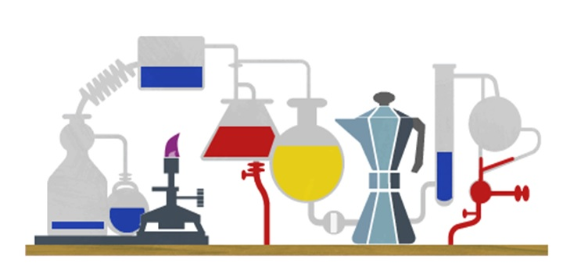

Slide 47

Design Principles by Google
Google design mantras (from the user perspective):
“Keep it brief”
“Delight me in surprising ways“
“It’s not my fault!“

Slide 48
Design Principles by Android
Principles developed by and for the Android User Experience Team to keep users' best interests in mind:
Enchant me
Simplify my life
Make me amazing!
iLearn Wiki:
https://developer.android.com/design/get-started/principles.html

Slide 49
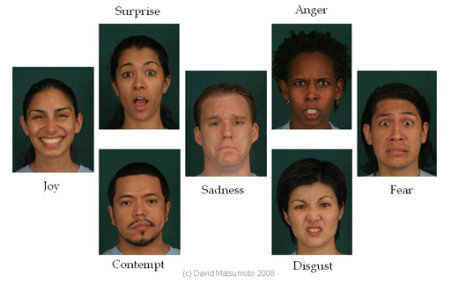
Getting in touch with emotions…

Slide 50
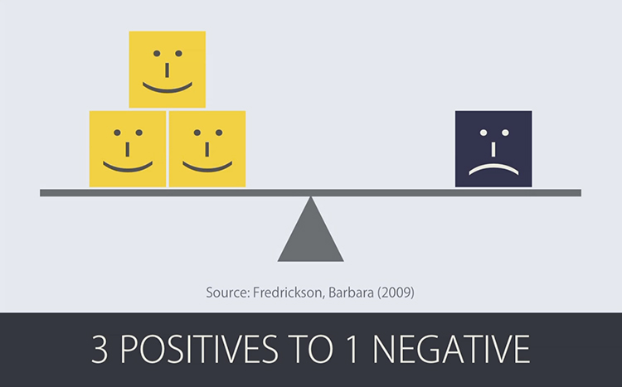
Google and Emotions
It takes 3 positive emotions to out-weight every one negative emotion

Slide 51
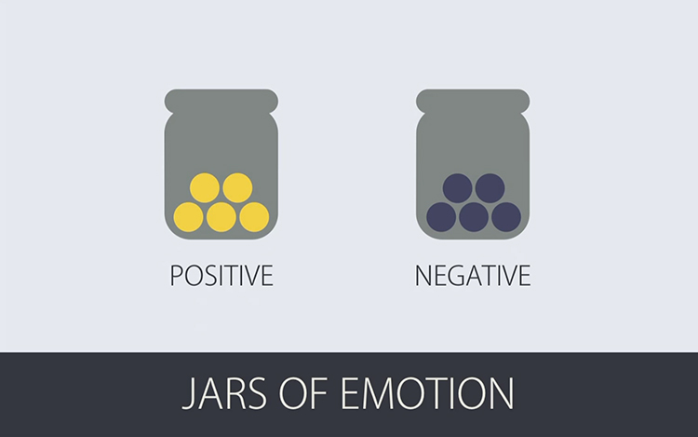
Google: 2 Jars of Marbles
Each time an Android feature lives up to expectations, 1 marble is placed in the good emotion jar. But every time it fails, that bad feature produces 3 marbles in the bad emotion jar.
Bad ideas stack up quickly!

Slide 52
Google
Question: How do you signal to a user that they have swiped to their final page of an app?
What if Google did nothing?
Breaks two rules:
I should always know where I am
“Am I on the last screen or what? WHAT A STUPID APP!”
It’s not my fault
“Why isn’t this stupid thing working??? I hate this!!!”
Bad marbles ☹

Slide 53
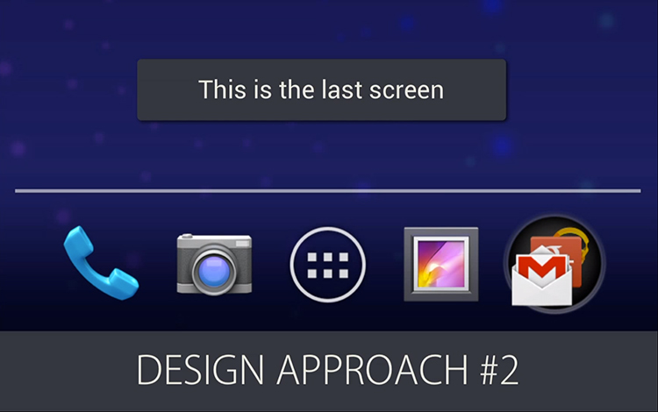
Google
Pop-up notification?
Breaks a rule: it’s not my fault
A pop-up is like being nagged, and makes the user feel like they did something wrong
Breaks a rule: only interrupt me if its important
Does it warrant a pop-up? It’s not am amber alert. Reaching the last page of your app isn’t going to destroy the world.
Bad marbles ☹

Slide 54

Google
So, what’s the best solution???
Google created a glimmering animation when users reach the last screen
Delighting users in a surprising way
Sprinkling encouragement
Uses pictures instead of words
Happy marbles ☺

Slide 55

Facebook
How does Facebook signal to a mobile user that he/she has viewed all feed posts?

Slide 56

Apple: User Centered Design
“When you stay focused on your users throughout the design process, you have the best chance of delivering a product that meets their needs. After you determine who your target audience is and what, precisely, your app helps them do, it works well to use that knowledge as a tool to shape every design decision.”
https://developer.apple.com/library/mac/documentation/UserExperience/Conceptual/OSXHIGuidelines/Strategies.html#//apple_ref/doc/uid/20000957-CH19-SW1

Slide 57

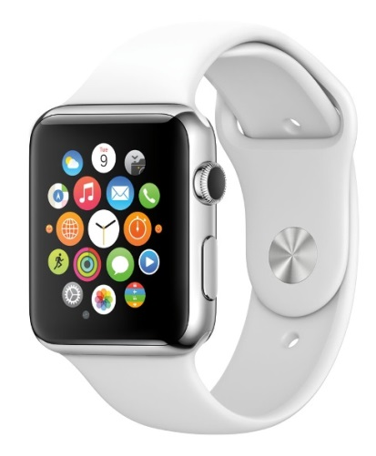
Extra Resources for UI Design
iLearn Wiki:
7 Rules for creating gorgeous UIs
Android design principles
OSX Design Principles/User Centered Design
Redesigning Apple Watch apps
Invision

Slide 58
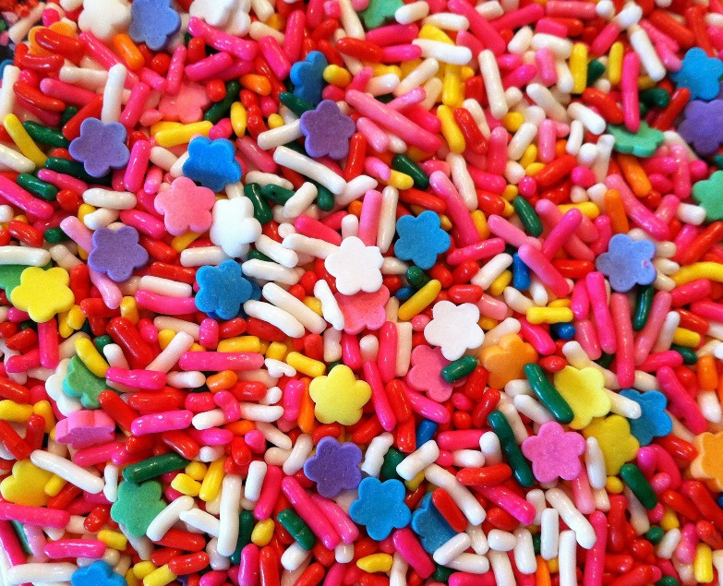
Great job!

Slide 59



Class Activity: Disney
Critically analyze the online system for ordering Disney theme part tickets:
Start with one-day ticket for one adult
Change to one-day ticket for two adults and one child
Change to multi-day passes
Can I visit Magic Kingdom and EPCOT in the same day?

Slide 60


Class Activity: Universal Studios
Critically analyze the online system for ordering Universal Studios theme part tickets:
Start with one-day ticket for one adult
Change to one-day ticket for two adults and one child
Change to multi-day passes
Can I visit Hogsmeade and Diagon Alley in one day?

Slide 61
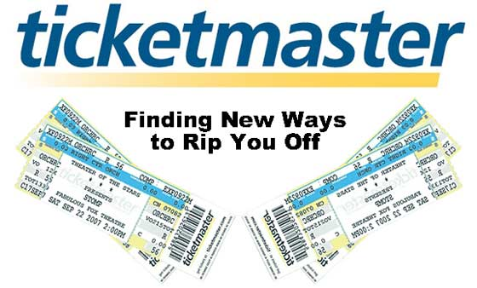
Class Activity: Ticketmaster
Critically analyze the online system for ordering concert tickets through Ticketmaster.com:
Look at seats for two people
Try to see what other seats are available on same day
Try to see what seats are available on a different day

Slide 62

Class Activity: Broadway.com
Critically analyze the online system for ordering theater tickets through Broadway.com:
Look at seats for two adult tickets
Try to see what other seats are available on same day
Try to see what seats are available on a different day

Slide 63
Group Activity
Each group select and critically analyze an interface according to UI design principles
Assignment:
Prepare brief presentation to class that covers the highlights and lowlights

Slide 64

Apple Design Principles
“Great software design incorporates a number of timeless principles for human-computer interaction. The principles described here form the foundation of elegant, efficient, intuitive, and delightful apps.”

Slide 65
Apple: Human Interface Design Principles
Principles:
Mental model
Metaphors
Explicit and Implied Actions
Direct Manipulation
User Control
Feedback and Communication
Consistency
Forgiveness
Aesthetic Integrity

Slide 66
Apple: User Centered Design
Principles for user-centered design:
Know your audience
Analyze user tasks
Build prototypes
Do user testing
Focus on solutions, not features

